Slide 1

Corporate Finance Lecture 8.1: Capital Structure: M&M Theorem, Cost of Capital (without tax)
Yuan Shi ©
HSBC Business School
Peking University

Slide 2
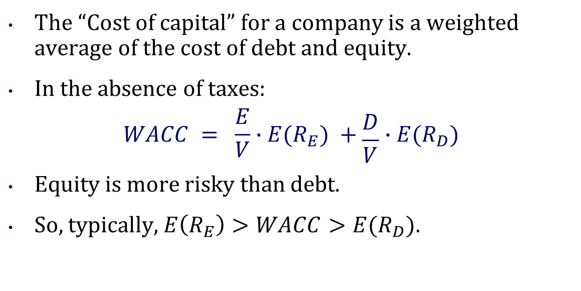
Cost of Equity and Debt
The “Cost of capital” for a company is a weighted average of the cost of debt and equity.
In the absence of taxes:
$$WACC = \frac{E}{V}∙E(R_{E}) +\frac{D}{V}∙E(R_{D})$$
Equity is more risky than debt.
So, typically, $E\left(R_{E}\right)>WACC>E(R_{D}).$

Slide 3
A Puzzle
A company’s cost of equity is 13% (R=13%) and its cost of debt is 10% (YTM=10%)
Does this mean that it is cheaper for this company to finance its projects with debt rather than equity?
Should this company issue debt and buy back stock shares?
Could this company lower its WACC by increasing D/V and decreasing E/V?

Slide 4
SML Revisited
The answer is: Not Necessarily!
Basic Idea: Equity is riskier than Debt.
This is why the return on equity should be higher than on debt
As long as both the return on equity and the return on debt are on the SML, the firm should be indifferent to issue debt vs. equity
If investors are getting a “fair” return according to the SML, the firm should not care whether it issues debt or equity

Slide 5
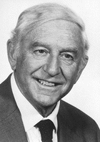
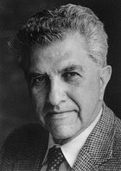
The M&M Theorem
Proposition I:
Without frictions, the Value of the Firm does NOT depend on its Capital Structure.
Franco Modigliani
Nobel Prize 1985
Merton Miller
Nobel Prize 1990

Slide 6
Intuition
Firm value is like a pie
Stems from cash flows assets generate
Then split between debt-holders and stockholders
But the size of the pie does not depend on how it is sliced
If financial markets work well, firms cannot increase value by tinkering with capital structure

Slide 7
Intuition
“Think of the firm, as a gigantic tub of whole milk. The farmer can sell the whole milk as is. Or he can separate out the cream and sell it at a considerably higher price than the whole milk would bring. (That’s the analogy of a firm selling low-yield and hence high-priced debt securities.) But, of course, what the farmer would have left would be skim milk with low butterfat content and that would sell for much less than whole milk. That corresponds to the levered equity. The M and M proposition says that if there were no costs of separation (and, of course, no government dairy support programs), the cream plus the skim milk would bring the same price as the whole milk.”
“Think of the firm, as a gigantic pizza, divided into quarters. If now you cut each quarter in half into eighths, the M and M proposition says that you will have more pieces but not more pizza.”
-- Merton Miller

Slide 8
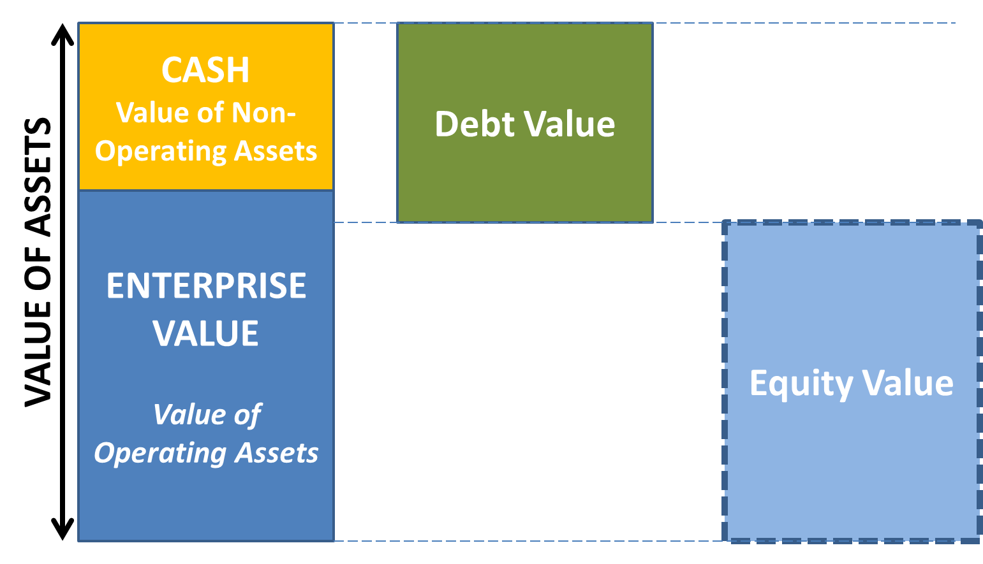
Splitting the Pie

Slide 9
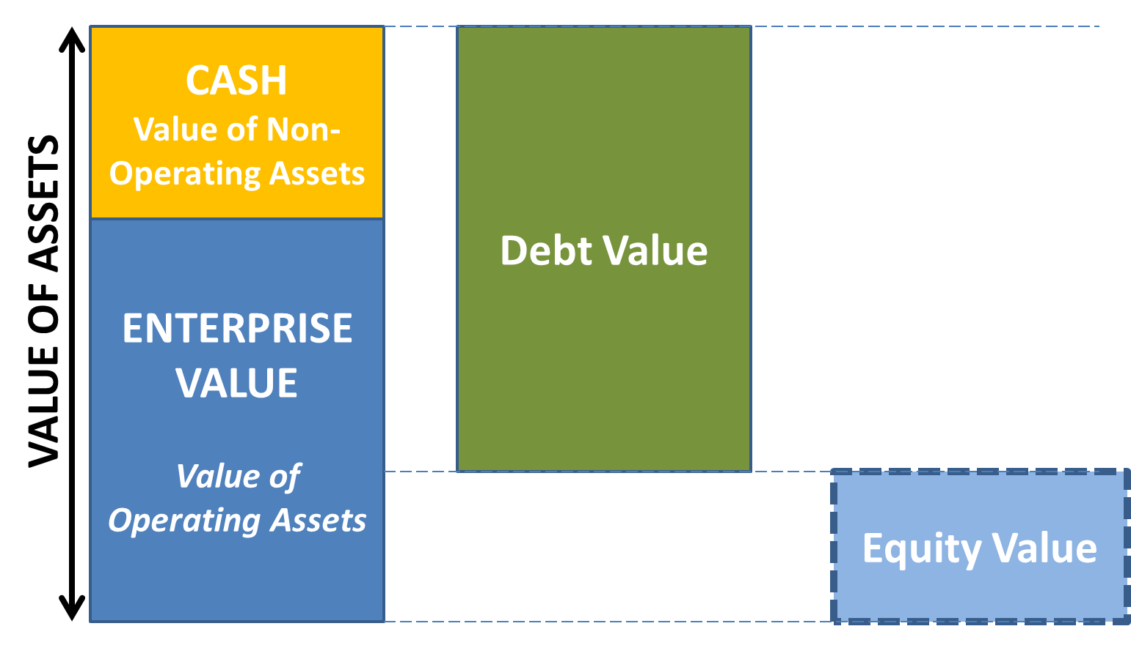
More Debt

Slide 10
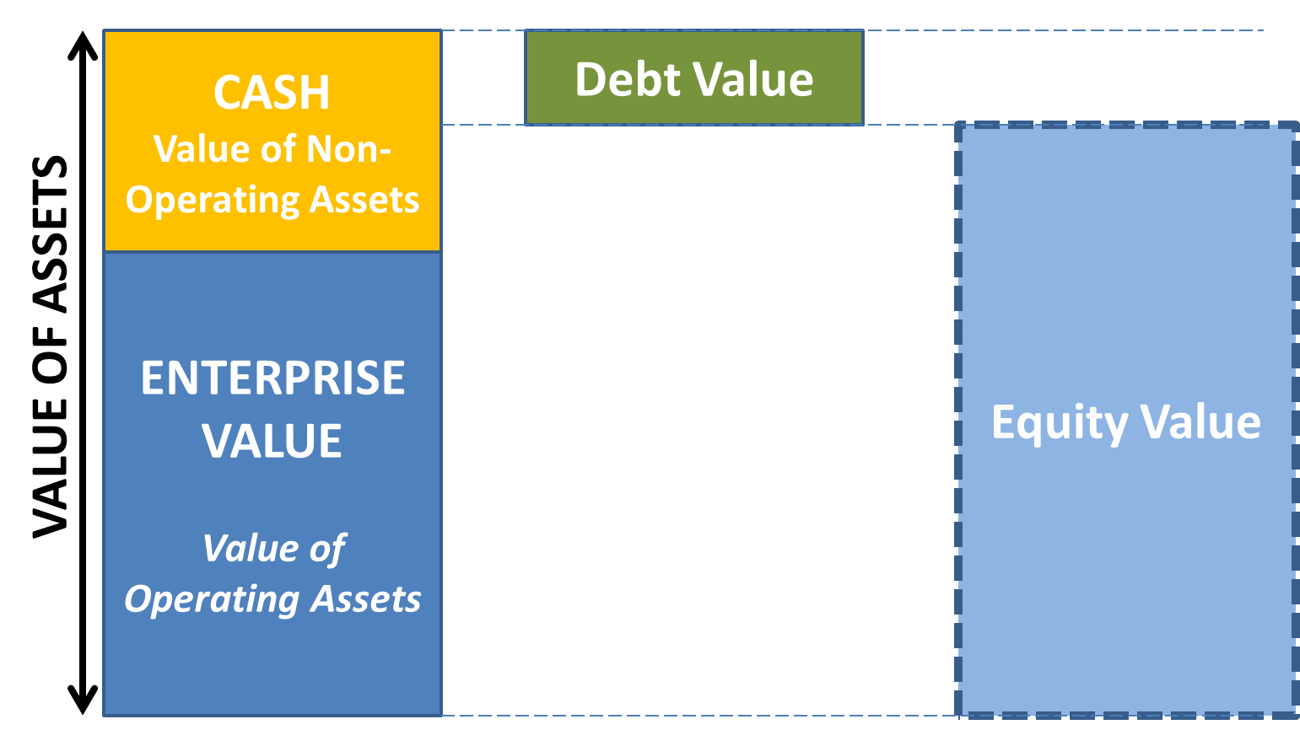
Less Debt

Slide 11
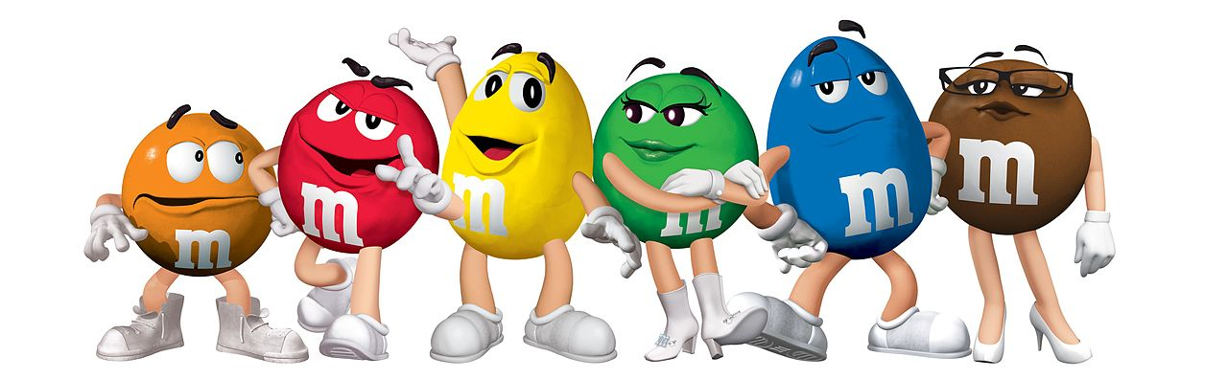
Irrelevance
What does “No Frictions” mean?
No tax shield (no taxes, or interest is paid after tax)
No consequences of financial distress for assets
Well functioning financial markets
Individuals can borrow and lend at the same rate as corporations
No information asymmetry and agency frictions

Slide 12
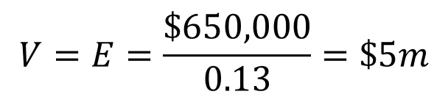
JELLYBEANS, INC.
Consider a firm with expected cash flows of $650,000 forever, zero debt, and cost of equity of 13%.
Firm has 500,000 shares. Jellybeans pays all its cash flows as dividends.
Assume no taxes.
Current value of the firm:
$$V=E=\frac{\$650,000}{0.13}=\$5m$$
Notes:
Regard CF = earnings

Slide 13
Recapitalization
CEO considers changing capital structure:
Borrow $2.5m long-term debt (which will be rolled over in future) at 10% interest.
Use it to repurchase half of the shares (= one-time dividend), proportionally from its shareholders
What happens to the value of the firm and its equity?
No effect on the cash flows → no change in firm value.
Share price is not affected as well.

Slide 14
Cash Flows
Before:
0 1 2 3 … infinity
650 650 650 …
V = $5m

Slide 15

Cash Flows
After:
E = V – D = $5m - $2.5m = $2.5m
Equity holders got $2.5m cash and are left with $2.5m equity
0 1 2 3 … infinity
650-250 650-250 650-250 …
V = $5m
D= $\frac{250,000}{0.1}$=$2.5m

Slide 16
Share Price
 | Current | Proposed
Asset | $5,000,000 | $5,000,000
Debt | $0 | $2,500,000
Equity | $5,000,000 | $2,500,000
Debt/Equity | 0 | 1
Share price | $10 | $10
Shares outstanding | 500,000 | 250,000
Interest rate | n/a | 10%

Slide 17
JELLYBEANS, INC.
How about EPS and ROE?
Before EPS: $650k/500k=$1.3, ROE: $650k/$5m=13%
After EPS: $400k/250k=$1.6, ROE: $400k/$2.5m=16%
EPS and ROE rise, but no effect on the stock price.
What changed?
Risk of the shareholder equity.
The variabilities of EPS and ROE also go up.
Equity holders are indifferent, since risk and expected return both increased.

Slide 18
Cash Flow Variability
BEFORE | Recession | Expected | Expansion
EBIT | $300,000 | $650,000 | $1,000,000
Interest | $0 | $0 | $0
Net Income | $300,000 | $650,000 | $1,000,000
EPS | $0.60 | $1.30 | $2.00
ROE | 6% | 13% | 20%
AFTER | Recession | Expected | Expansion
EBIT | $300,000 | $650,000 | $1,000,000
Interest | $250,000 | $250,000 | $250,000
Net Income | $50,000 | $400,000 | $750,000
EPS | $0.20 | $1.60 | $3.00
ROE | 2% | 16% | 30%

Slide 19
Exercise
Try it!
Ch16-16 MM Proposition I Levered, Inc., and Unlevered, Inc., are identical in every way except their capital structures. Each company expects to earn $18 million before interest per year in perpetuity, with each company distributing all its earnings as dividends. Levered’s perpetual debt has a market value of $65 million and costs 8 percent per year. Levered has 1.9 million shares of stock outstanding that sell for $98 per share. Unlevered has no debt and 3.8 million shares outstanding, currently worth $71 per share. Neither firm pays taxes.
Is Levered’s stock a better buy than Unlevered’s stock?
Is Levered’s stock relatively underpriced compared to Unlevered?

Slide 20
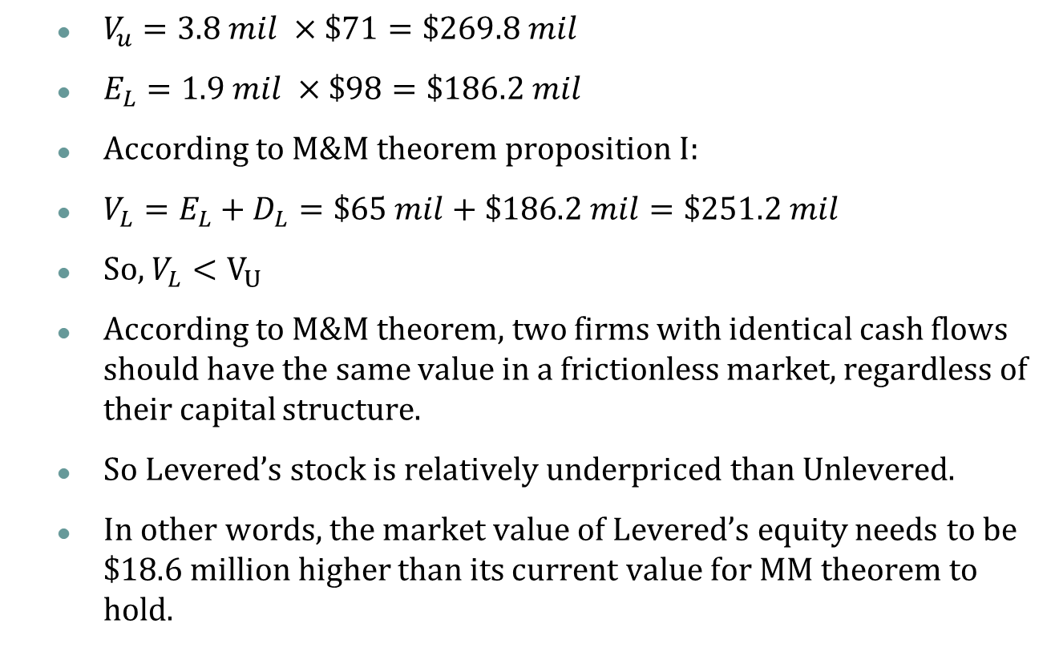
Exercise
Try it!
$V_{u}=3.8 mil ×\$71=\$269.8 mil$
$E_{L}=1.9 mil ×\$98=\$186.2 mil$
According to M&M theorem proposition I:
$V_{L}=E_{L}+D_{L}=\$65 mil+\$186.2 mil=\$251.2 mil$
So, $V_{L}<V_{U}$
According to M&M theorem, two firms with identical cash flows should have the same value in a frictionless market, regardless of their capital structure.
So Levered’s stock is relatively underpriced than Unlevered.
In other words, the market value of Levered’s equity needs to be $18.6 million higher than its current value for MM theorem to hold.

Slide 21
Individual Shareholders
Capital structure is irrelevant for firm value in such a frictionless market.
So should we allow managers to choose any level of capital structure discretionary?
Before we say yes, we need to consider individual shareholders’ payoffs.
Recall that this financial market is frictionless, and individual investors can borrow and lend at the same rate as corporations.

Slide 22
Homemade Leverage
Suppose there is an investor who holds 1,000 shares in JellyBeans, Inc and who dislikes leverage.
What can she do if the management decides to change capital structure?
When the firm was recapitalized, 500 of her shares were purchased back with $5,000 payment.
She could lend out the $5,000 at 10% interest rate.
Before recapitalization she was entitled to 1,000×$1.3=$1,300 of firm’s profits.
After recapitalization she is entitled to 500×$1.6=$800 of firm’s profits and $5,000×10%= $500 of interest income.

Slide 23
Punchline
Capital structure is irrelevant as long as it does not affect the total cash flows generated by the assets.
Investors can achieve the payoff from their desired capital structure using homemade leverage.
Assuming a well-functioning financial market.

Slide 24
Exercise
Try it!
Ch16-22 Homemade Leverage The Veblen Company and the Knight Company are identical in every respect except that Veblen is unlevered. The market value of Knight Company’s 6 percent bonds is $1.6 million. Financial information for the two firms appears here. All earnings streams are perpetuities. Neither firm pays taxes. Both firms distribute all earnings available to common stockholders immediately.
An investor who can borrow at 6 percent per year wishes to purchase 5 percent of Knight’s equity. Can he increase his dollar return by purchasing 5 percent of Veblen’s equity if he borrows so that the initial net costs of the two strategies are the same?
An investor has the money to purchase 5percent of Knight, and can borrow at 6%.
With the same initial investment, if he buys 5% of Veblen, will his annual dollar return be higher?
 | Veblen | Knight
Estimated Operating Income | $610,000 | $610,000
Interest |  | $96,000
Market Value of Equity | $4,400,000 | $3,550,000
Market Value of Debt |  | $1,600,000

Slide 25
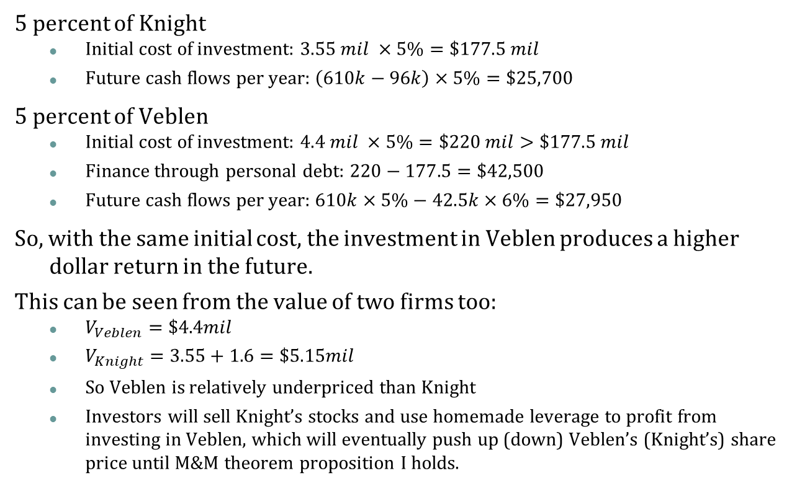
Exercise
Try it!
5 percent of Knight
Initial cost of investment: $3.55 mil ×5\%=\$177.5 mil$
Future cash flows per year: $\left(610k−96k\right)×5\%=\$25,700$
5 percent of Veblen
Initial cost of investment: $4.4 mil ×5\%=\$220 mil>\$177.5 mil$
Finance through personal debt: $220−177.5=\$42,500$
Future cash flows per year: $610k×5\%−42.5k×6\%=\$27,950$
So, with the same initial cost, the investment in Veblen produces a higher dollar return in the future.
This can be seen from the value of two firms too:
$V_{Veblen}=\$4.4mil$
$V_{Knight}=3.55+1.6=\$5.15mil$
So Veblen is relatively underpriced than Knight
Investors will sell Knight’s stocks and use homemade leverage to profit from investing in Veblen, which will eventually push up (down) Veblen’s (Knight’s) share price until M&M theorem proposition I holds.

Slide 26
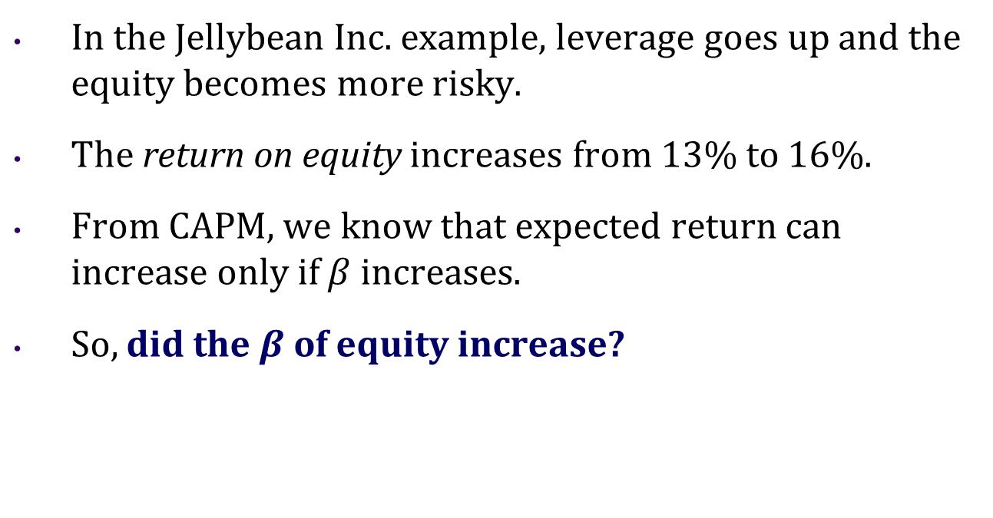
More Intuition
In the Jellybean Inc. example, leverage goes up and the equity becomes more risky.
The return on equity increases from 13% to 16%.
From CAPM, we know that expected return can increase only if $β$ increases.
So, did the$β$ of equity increase?

Slide 27
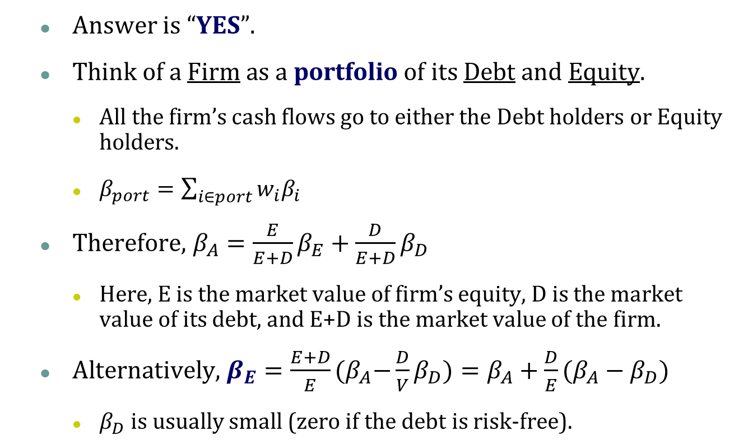
Equity Beta
Answer is “YES”.
Think of a Firm as a portfolio of its Debt and Equity.
All the firm’s cash flows go to either the Debt holders or Equity holders.
$β_{port}=\sum_{i∈port}{w_{i}β_{i}}$
Therefore, $β_{A}=\frac{E}{E+D}β_{E}+{\frac{D}{E+D}β}_{D}$
Here, E is the market value of firm’s equity, D is the market value of its debt, and E+D is the market value of the firm.
Alternatively, $β_{E}=\frac{E+D}{E}{(β}_{A}−\frac{D}{V}β_{D})=β_{A}+\frac{D}{E}(β_{A}−β_{D})$
$β_{D}$ is usually small (zero if the debt is risk-free).

Slide 28
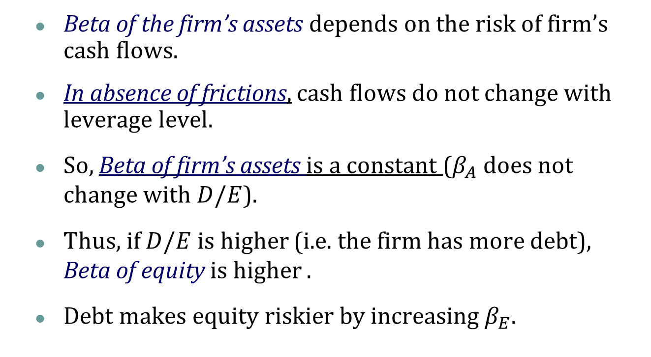
Leverage and Beta
Beta of the firm’s assets depends on the risk of firm’s cash flows.
In absence of frictions, cash flows do not change with leverage level.
So, Beta of firm’s assets is a constant ($β_{A}$ does not change with$D/E$).
Thus, if $D/E$ is higher (i.e. the firm has more debt), Beta of equity is higher .
Debt makes equity riskier by increasing $β_{E}$.

Slide 29
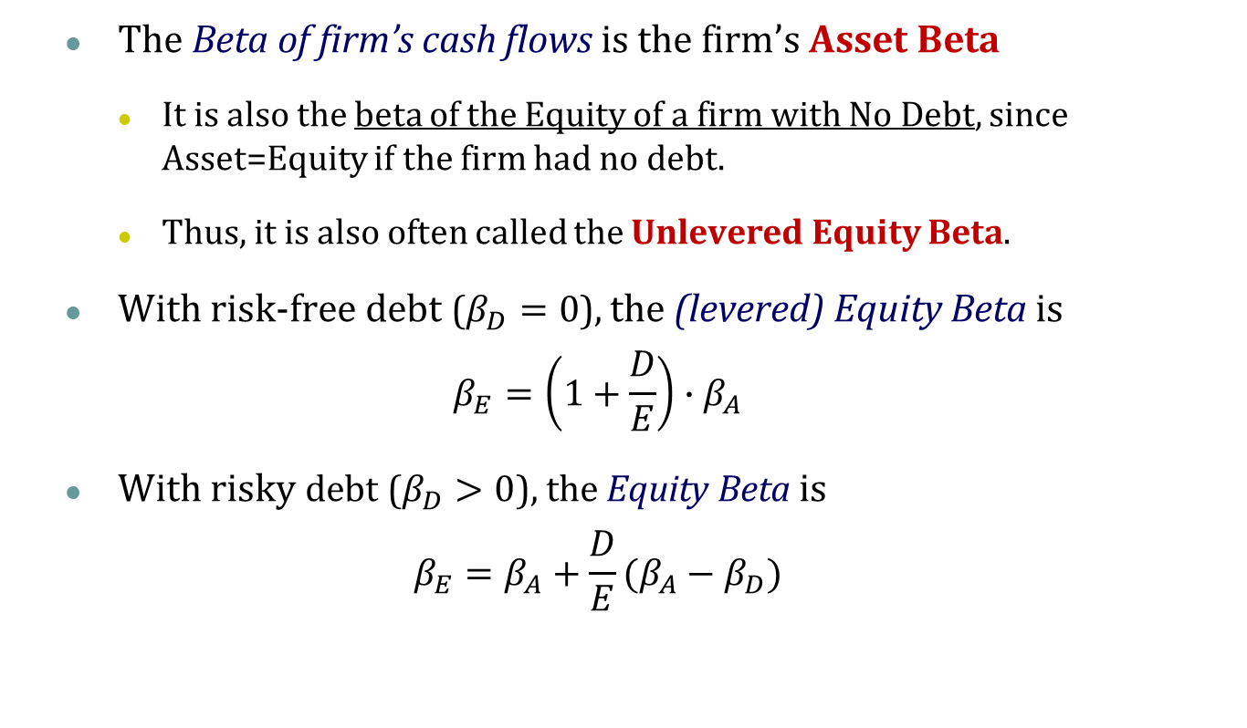
Leverage and Beta
The Beta of firm’s cash flows is the firm’s Asset Beta
It is also the beta of the Equity of a firm with No Debt, since Asset=Equity if the firm had no debt.
Thus, it is also often called the Unlevered Equity Beta.
With risk-free debt ($β_{D}=0$), the (levered) Equity Beta is
$$β_{E}=\left(1+\frac{D}{E}\right){∙β}_{A}$$
With risky debt ($β_{D}>0$), the Equity Beta is
$$β_{E}=β_{A}+\frac{D}{E}(β_{A}−β_{D})$$

Slide 30
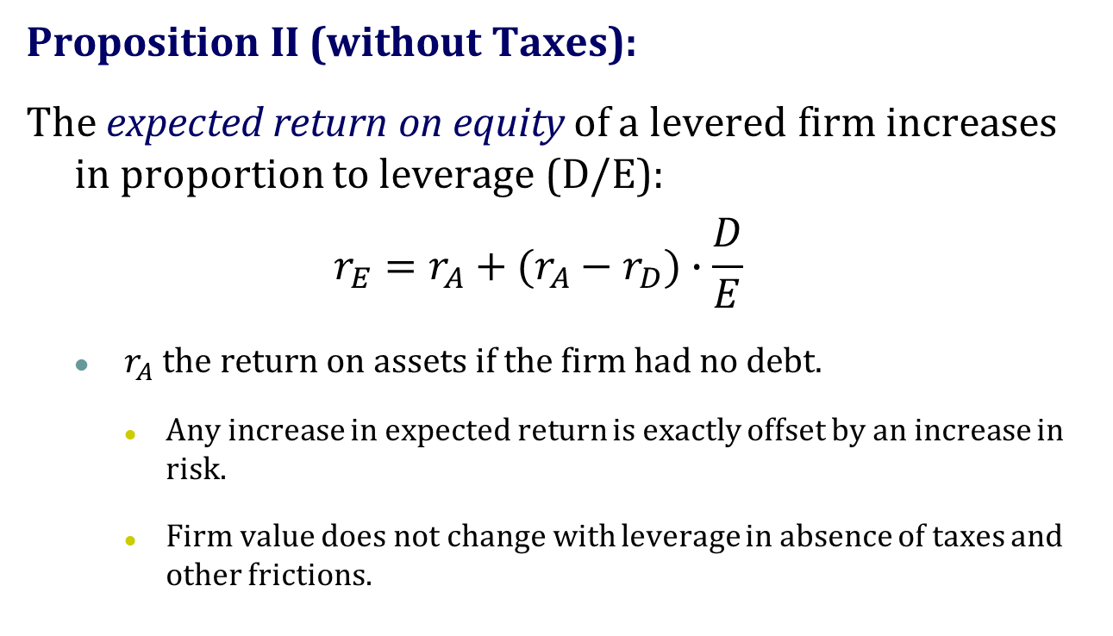
The M&M Theorem
Proposition II (without Taxes):
The expected return on equity of a levered firm increases in proportion to leverage (D/E):
$$r_{E}=r_{A}+(r_{A}−r_{D})∙\frac{D}{E}$$
$r_{A}$ the return on assets if the firm had no debt.
Any increase in expected return is exactly offset by an increase in risk.
Firm value does not change with leverage in absence of taxes and other frictions.

Slide 31
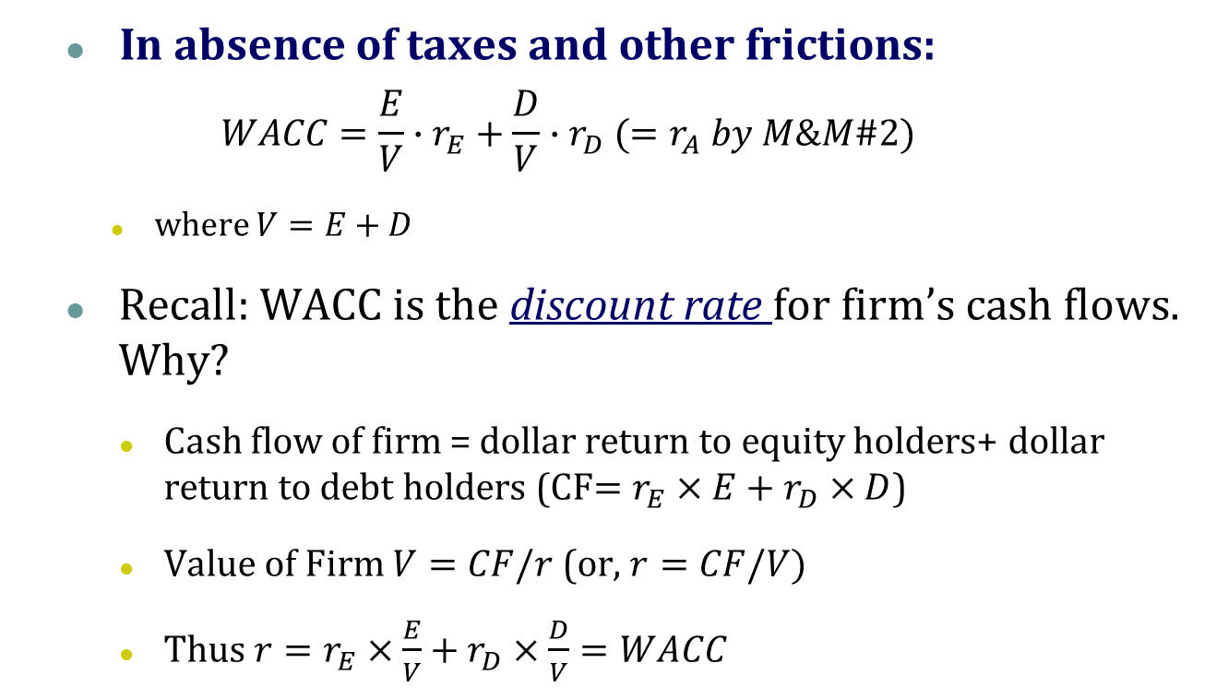
Cost of Capital Revisited
In absence of taxes and other frictions:
$$WACC=\frac{E}{V}∙r_{E}+\frac{D}{V}{∙r}_{D}(=r_{A} by M\&M\#2)$$
where $V=E+D$
Recall: WACC is the discount rate for firm’s cash flows. Why?
Cash flow of firm = dollar return to equity holders+ dollar return to debt holders (CF$=r_{E}×E+r_{D}×D$)
Value of Firm $V=CF/r$ (or, $r=CF/V)$
Thus $r=r_{E}×\frac{E}{V}+r_{D}×\frac{D}{V}=WACC$
Notes:
Intuitively, firm is a portfolio of equity and debt;
The required return on assets is the weighted average of required return on equity and debt (WACC);
The discount rate for firm’s cash flow is exactly the required return on asset.

Slide 32




Connections
In absence of taxes and other frictions:
Cost of Capital
$$R_{E}$$
$$R_{A}$$
$$WACC=R_{A}$$
$$R_{D}$$
D/E

Slide 33
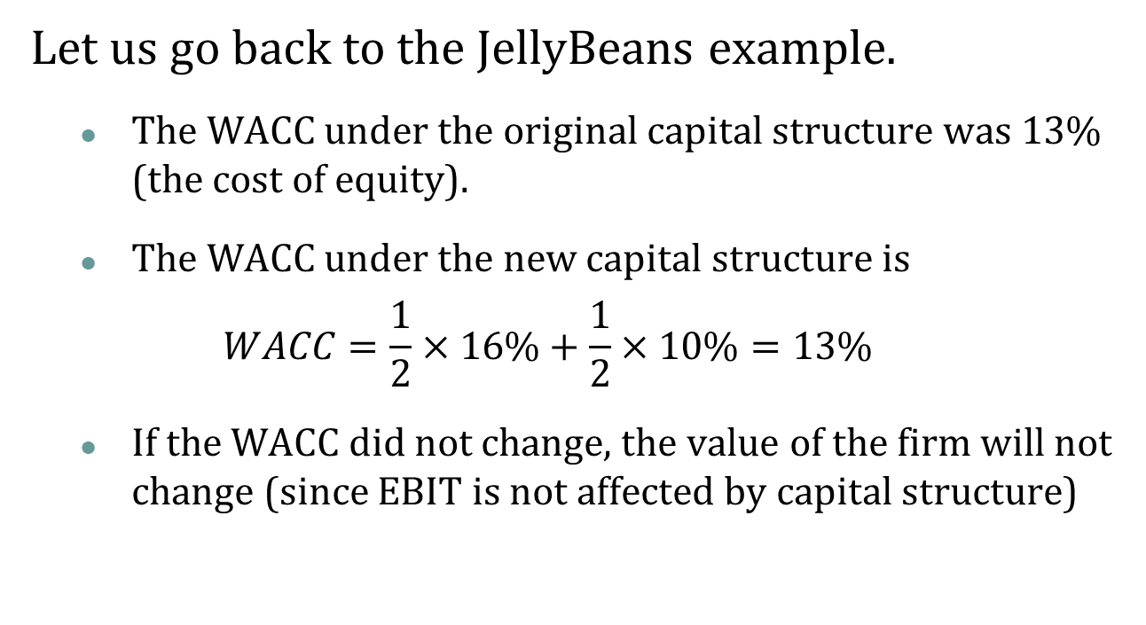
Debt and WACC
Let us go back to the JellyBeans example.
The WACC under the original capital structure was 13% (the cost of equity).
The WACC under the new capital structure is
$$WACC=\frac{1}{2}×16\%+\frac{1}{2}×10\%=13\%$$
If the WACC did not change, the value of the firm will not change (since EBIT is not affected by capital structure)

